Slide 1
SPE-166486-MS Delivering Key WITSML Measured and
Interpreted Well Information
Through RESQML V2 for Reservoir
Characterization and Flow Simulation
Raphaele C. Henri-Bally, TOTAL, Jean-François Rainaud, IFPen, Laurent Deny, Paradigm, Chris A. Legg, BP America, Michael J. King, Texas A&M, Philippe Verney, Geosiris, Jana Schey, Energistics

Slide 2
Overview
Slide 2
What is the problem?
Why is RESQML useful?
Why is WITSML part of it?
How do we construct the connection?
This is a REVOLUTION
Next steps
Notes:
Here is the outline of this presentation. We will describe the problem we are addressing here, describe how RESQML is useful , Where WITSML comes into play, and how we construct this connection. We will then conclude on the way ahead.

Slide 3
Slide 3
1. What is the problem?

Slide 4
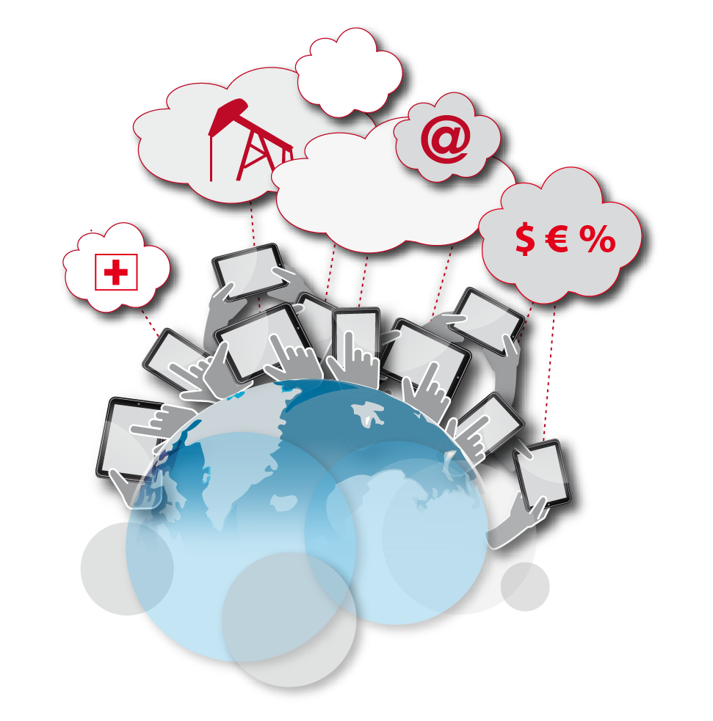
Slide 4
Tout et Tout de suite (Everything, and right now!)
A well provides new results within a field
Does my model match the newest raw and interpreted well data ?
NO!
Which part of the model needs to be refined/updated ?
Pull out that part and revisit the interpretation process
Find the wrong assumption
Correct consequences of assumption on model
Rebuild partial model with these corrections
Rebuild full reservoir representation / interpretation
Notes:
We all know this story:
We need integration of the data across applications
But also ability to access the entire data set , or the most pertinent part of it,
QUICKLY, Without having to enter any technical application
Because there are much more readers than writers
And the fact is that today only the people who create the data can access it, through the very applications that create it or consume it.

Slide 5
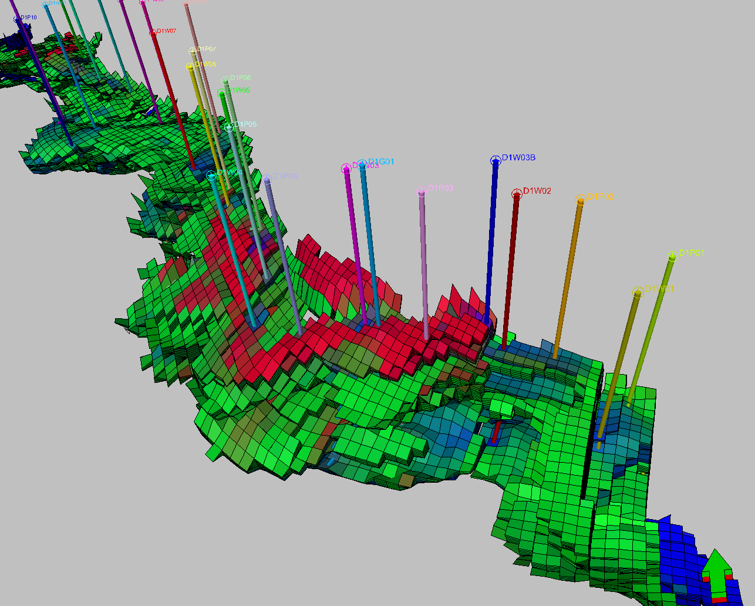
Slide 5
Visualization of saturations and wells
Well probe
Cell probe
Detailed structural description, wells and saturation evolution
Notes:
Here are a few examples of how the new data is quickly contradicting the model of a reservoir
When we visualize saturation and wells

Slide 6
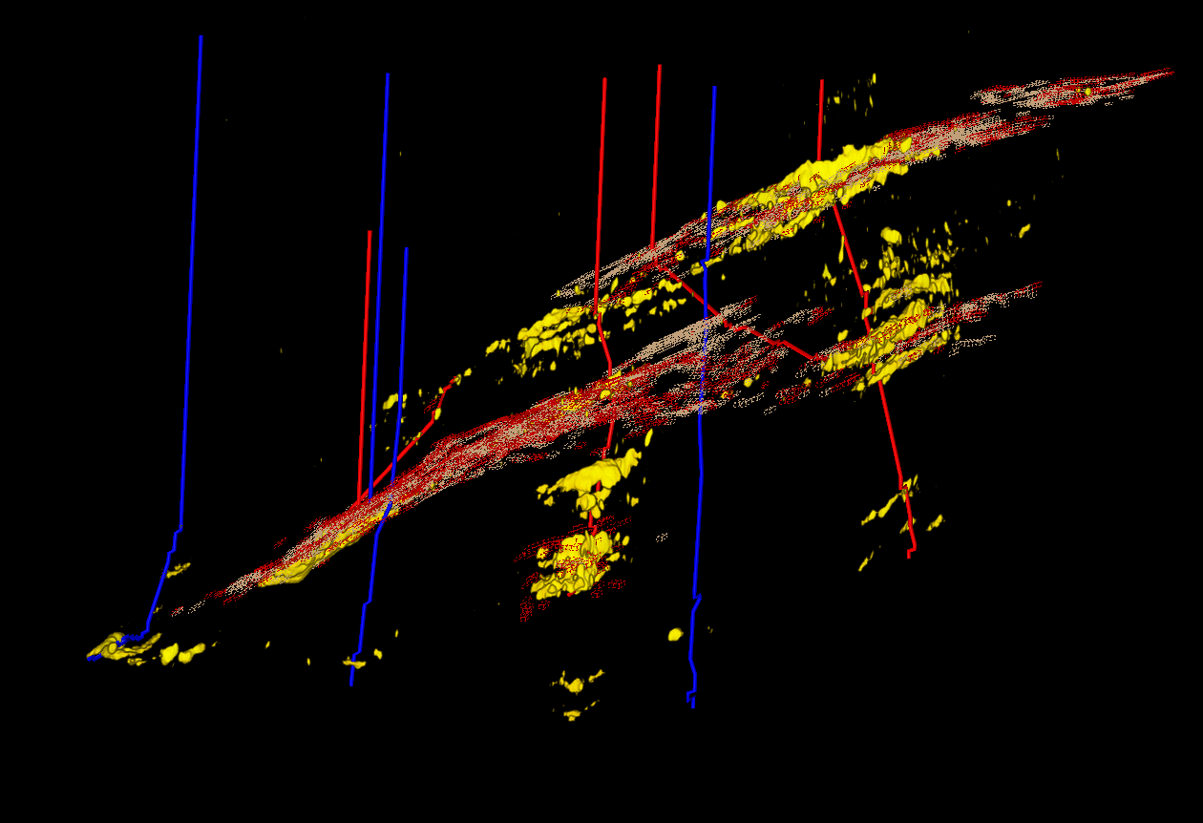
Slide 6
Integrated visualization example 1: mismatch between
completion data and model representation
producer
Water injector
Grid skeleton for cells with
ΔSGAS >0.03 at 4D time T
4D Attribute associated to ΔSG>0
Notes:
Here a mismatch between completion data and model representation

Slide 7
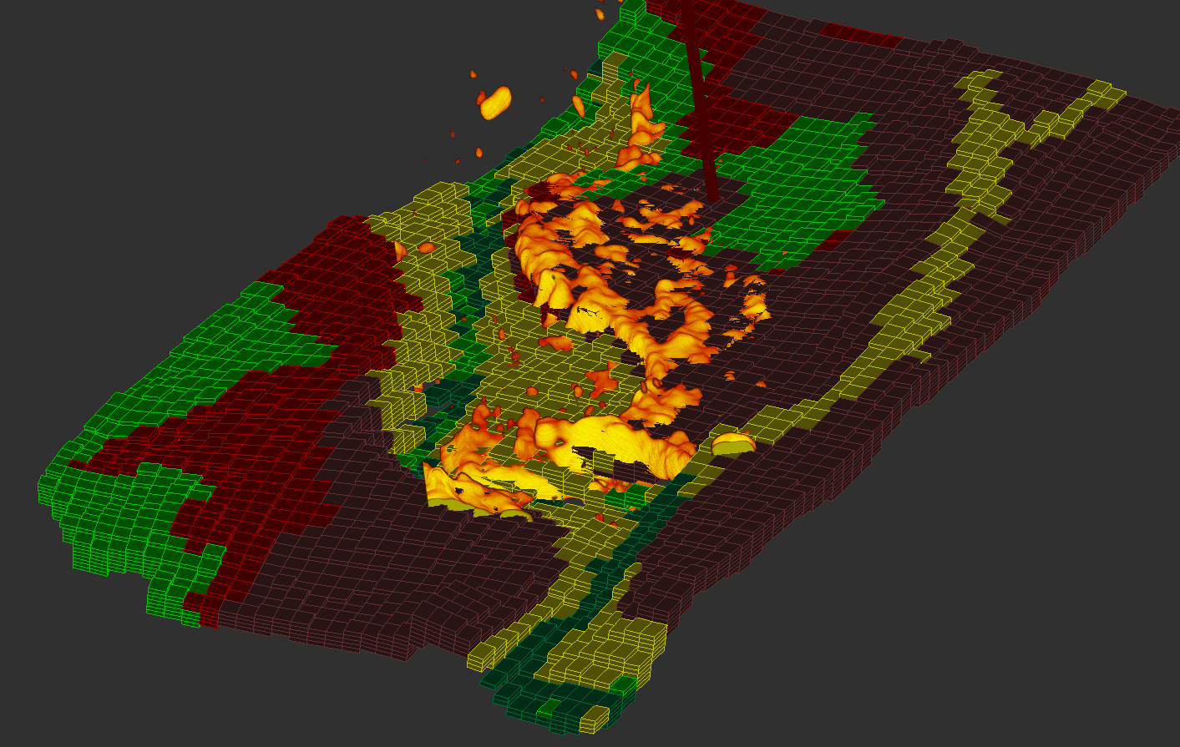
Slide 7
Integrated visualization example 2 :
4D response to gas
projected trajectory
Facies color code
Cum production
oil & gas bubble
4D seismic gas
anomaly
3D reservoir model facies grid
Notes:
Idem from other angle

Slide 8
Slide 8
2. Why is RESQML useful?

Slide 9
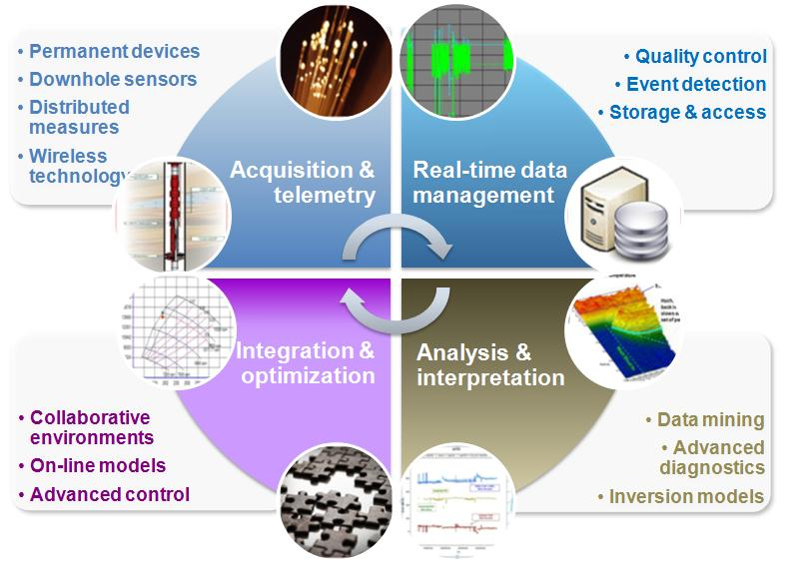
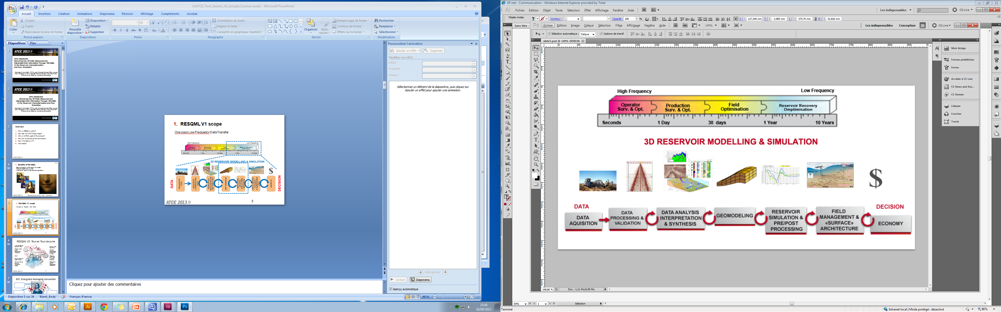
Slide 9
2.1 RESQML V1 scope
One pass Low Frequency Data Transfer
Notes:
In RESQML, we have already integrated data from the grid to the simulation deck.
In one big file.

Slide 10
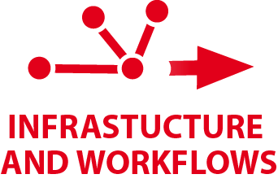



Slide 10
2.2 RESQML V2 scope
Large model workflows
Modular documents,
Packaging specification using Energistics OPC implementation
Reservoir scale Structural/Stratigraphic Organization
and Framework,
Geo-chronological cross reference table
Corner Point + Unstructured + Radial Grids
Relationships with Structural/Stratigraphic Framework
WITSML objects, including:
Trajectories, Markers, logs
Notes:
RESQML V2 is much more ambitious:
Not only do we enlarge the scope to include the structural / Stratigraphic framework seismic interpretation,
We also take advantage of the existing exchange format of WITSML to import the entire spectrum of well data into our model.
And as we know that models grow fast, we make the model MODULAR, using the standard Open Packaging convention in a specific way dedicated to all Energistics standards.
Let us review these points more closely for a second:

Slide 11
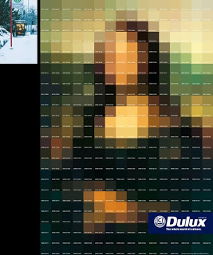

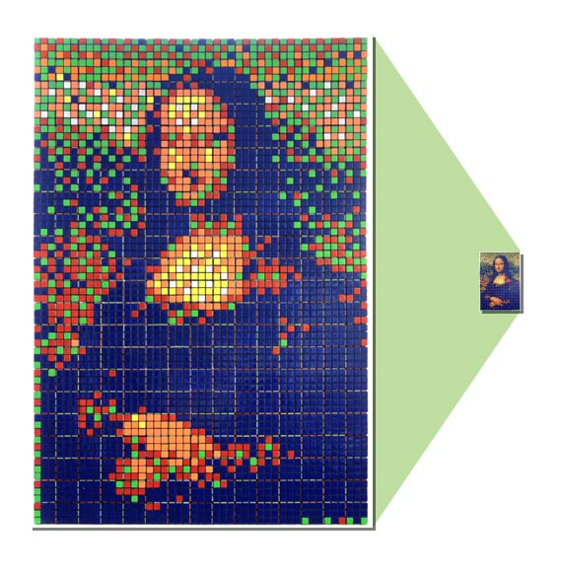

Slide 11
Infrastructure and Workflows: Modular Documents
Improve consistency of the reservoir models
Reduce geoscience study cycles
Audit trail of reservoir development decisions
SPE-166486-MS • Delivering Key WITSML .. • R.C.Henri-Bally
Notes:
Why do we need to spit the model?
The focus we have on our field changes as the construction of the model evolves.
And we can not carry the entire data set each time we want to enhance a detail or would move as slowly as a turtle.
Evolution of computers and data centers call for big models for simulation. But our minds do not need all this information at any one time. Teams work in parrallel, and we need to consolidate the most up-to-date version at any one time for our TOUT ET TOUT DE SUITE boss.
With modular technology and the capability to integrate the improved piece into the full model, anyone from the lawyer to the manager to the HSE to the driller and reservoir engineer, may access any subset of the data -which may not come from a single source- on any device anywhere, instantly

Slide 12



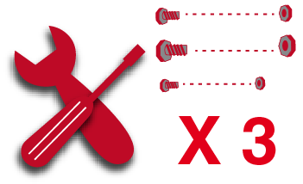

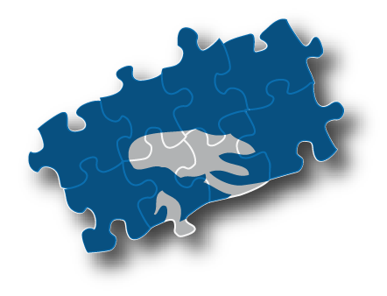

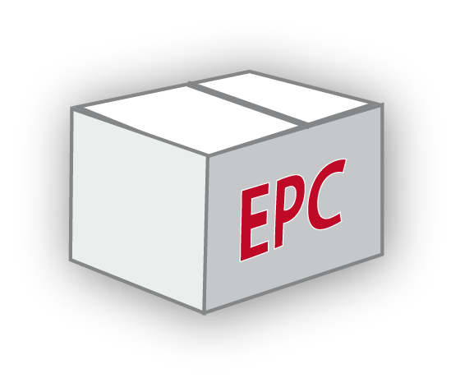




Slide 12
Infrastructure and Workflows: EPC: Energistics Packaging Convention
The model interpretation and representation
The relationships that connect the pieces together
The inventory of all the parts of the model that are to be reworked
The container of the partial extraction
Notes:
The basic principal of EPC is the IKEA box. Not only does it contain the different data types that constitute the piece we want to work on,
It also includes the full threads that allow to rreturn it into the full model
When a change is calling for update of the connection, this is worked through versioning

Slide 13
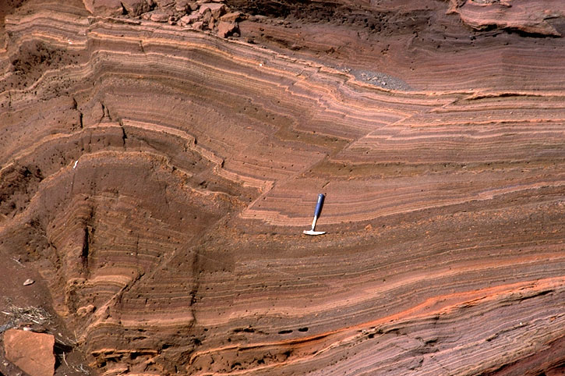

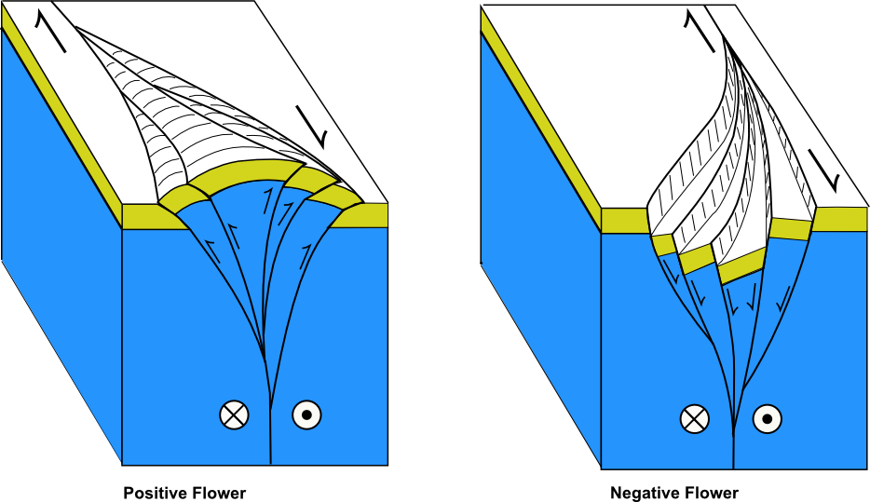
Slide 13
Organization: Structuring the knowledge with
RESQML V2: Step 1
Feature:
A feature corresponds to a subsurface phenomena. Features may be geological (Faults) or technical (boundaries).
Interpretation:
Representation:
An interpretation is a single consistent description of a feature.
A feature may have one or more Interpretations.
A representation is a digital expression of a line, surface, or volume that corresponds to a given interpretation.
SPE-166486-MS • Delivering Key WITSML .. • R.C.Henri-Bally
Notes:
Let us go quickly through the structure of information. We can call this the 4th dimension constituted by all the threads that link the RESQML pieces information together.
We differentiate the fact from our understanding of it, and from our representation of it.
And we expect the 3 levels to correspond to different parralel spaces, hopefully linked with each other.
We call feature an object that exists in the outside world:
A geological feature such as a fault, a geobody, a water level
We call Interpretation the intellectual process by which we comprehend this feature;
And there may be even more interpretations than interpreters , right?
Now our thinking only communicate sto others through representations on workstations tools.
A same interpretation can be represented on several scales, for different purposes using different software.
Therefore we distinguish representations as another parallel space in which we treat our study.

Slide 14
Slide 14
2.1 Structuring the knowledge with
RESQML V2: Step 2
Relationships Organisations
C
B
D
Relative position of geological layers
A
E
Relationship between faults
We can define a closed trap and specific reservoir components
These faults
rejoin in a specific geometric pattern
Notes:
We first build the threads from observation through reflection into representations. As the study progress we add more connections across our representations, then our interpretations, and confront those to reality for validation.
These threads , once consistent, may be called Organizations.

Slide 15
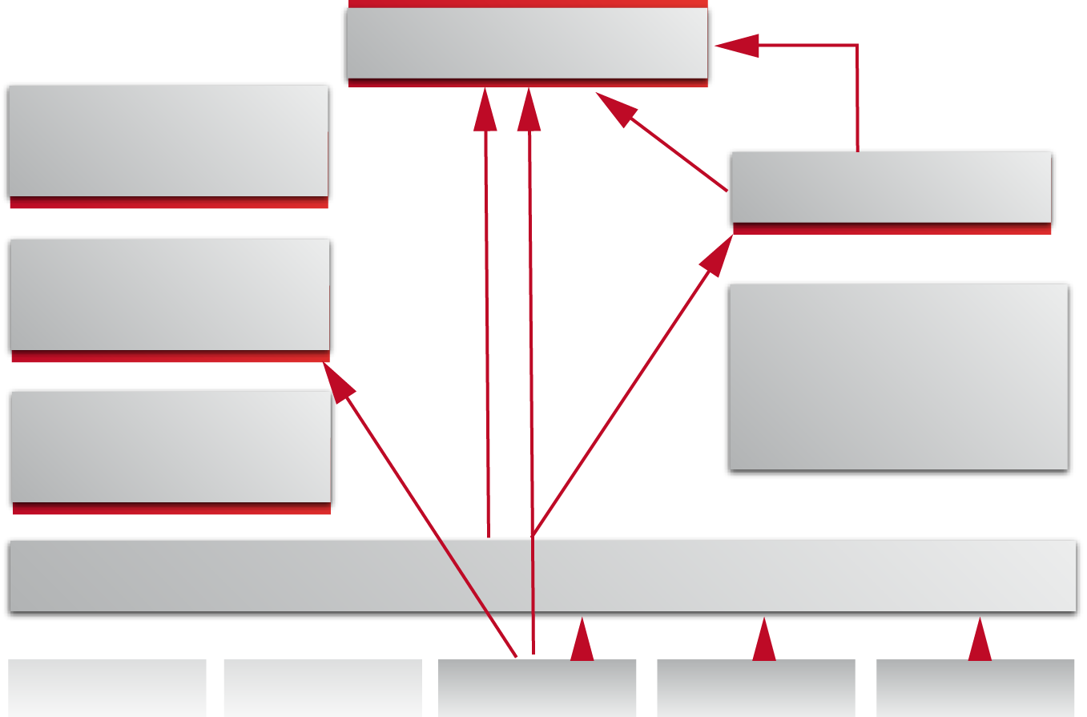
Slide 15
Organization: Different Facets of Organisations
Feature Interpretation class inheritance and cross-package relationships
Abstract Entity
Feature interpretation
Boundary Feature Interpretation
HorizonInterpretation
Contact interpretation
Boundary Feature Interpretation
FaultInterpretation
Rock Feature Interpretation
StarigraphicLine
Interpreation
Abstract Organisation Interpretation
External Reference
External Reference
Structural
Organisation
Stratigraphic Organisation
Fluid Organisation
Notes:
We distinguish Structural Organizations, Stratigraphic organizations, and Fluids organizations.
We associate relationships between Fault Interpretations and Horizon interpretations in the Structural Organization.
We confirm out stratigraphic line interpretation with our Stratigraphic organization.
And so forth.
All these organizations have commonalities, that are nicely shared through the abstract entities in our UML modeling.

Slide 16
Slide 16
3. Why is WITSML part of it?

Slide 17
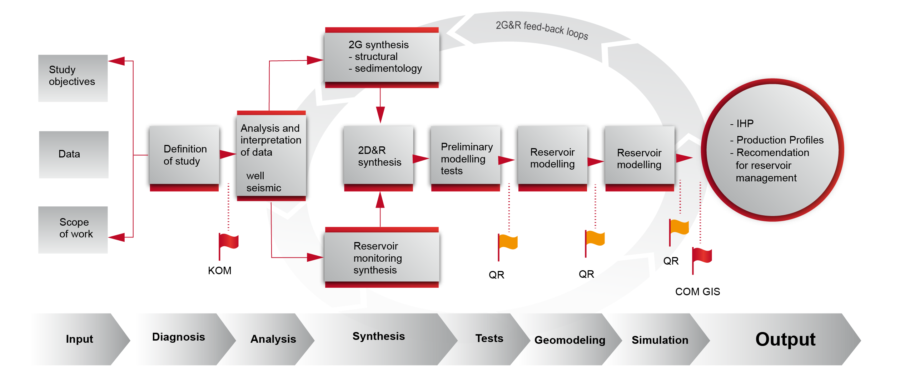
Slide 17
WITSML : When do we need Well Data
to build the Earth model ?
WITSML Domain
WITSML Domain
RESQML Domain
Well+ Wellbore + Geometry
from WITSML
Well log + lithology + interpreted logs
From both WITSML and PPDM
PRODML and PPDM info
Common depth scale or WellLog Frame for all well data input
Notes:
We need different types of well information at the various stages of the model building process:
We need the raw or basic interpreted well data at the beginning of our study: well, wellbore inventory with associated trajectory and markers.
We also need enhanced well information during the Geological / Geophysical interpretation stage.
Then we begin with the model construction
This model is then tested against well testing , PVT, Fluid data coming again from the WITSML/PRODML world. This is the later stage of the process. This one will be addressed in version 3 of RESQML. Our focus here is to solve the first stage of input, till the construction of the blocked wells within the grid.

Slide 18
Slide 18
4. How do we construct the connection?
Notes:
Now how do we go about it?

Slide 19
Slide 19
4.1 From the Driller to the Reservoir Engineer
1. Create a permanent reference geometry:
the Wellbore Frame along the Wellbore Trajectory
Use a single scale: MD
Make sure the origin of the log data is specified
Convert to Local CRS for RESQML
Choose sampling interval for each log type
2. Attach Properties to this reference geometry:
Properties may be on the ticks (nodes), or between ticks (intervals)
MD
Notes:
Sorry dear drillers and production engineers, the truth is that for the reservoir engineer, the well is simple. It consists in a 1D line from surface to bottom, on which are « hung » geological, petro physical, and reservoir information just as Christmas hanging ornaments (individual data values) and garlands ( data valid on an interval).
So we need our Christmas tree for that.
Because we know that positioning is the nervous center of this process, we make sure we work on a unique positioning of the information by importing first the WITSMLTrajectory. We use the Global CRS and datum of the WITMLS data set. We know that you might use different rigs along the various data acquisition, so we make sure we convert to the same datum. Would need requires (grid purposes for example), we convert this trajectory to the local CRS of the study.
The WITMSL Trajectory object ( the final driller validated one) is imported as Stations positions and vectors for dip and azimuths at these stations. The construction lets the reservoir engineer choose from different interpolation algorithms in between these stations, although we know that proper MD positioning only comes from reconstructing the path using the Minimum Curvature algorithm.
Once this is created we can attach the data values:

Slide 20

Slide 20
WELLBORE FRAME APPROACH
NODE
INTERVAL
52.5
12
52.5
NODE
INTERVAL
5.2
24
4.4
3.6
35
95.3
17.8
47
27.8
77.6
Notes:
We call the construction made from the WITSML Trajectory the WELLBOREFRAME.
Once the path is reconstructed, we sample it the way we need the log, or other kind of well data to be positioned.
The nodes are referencing the spot values
and the segments are used for interval values such as geological intervals.

Slide 21
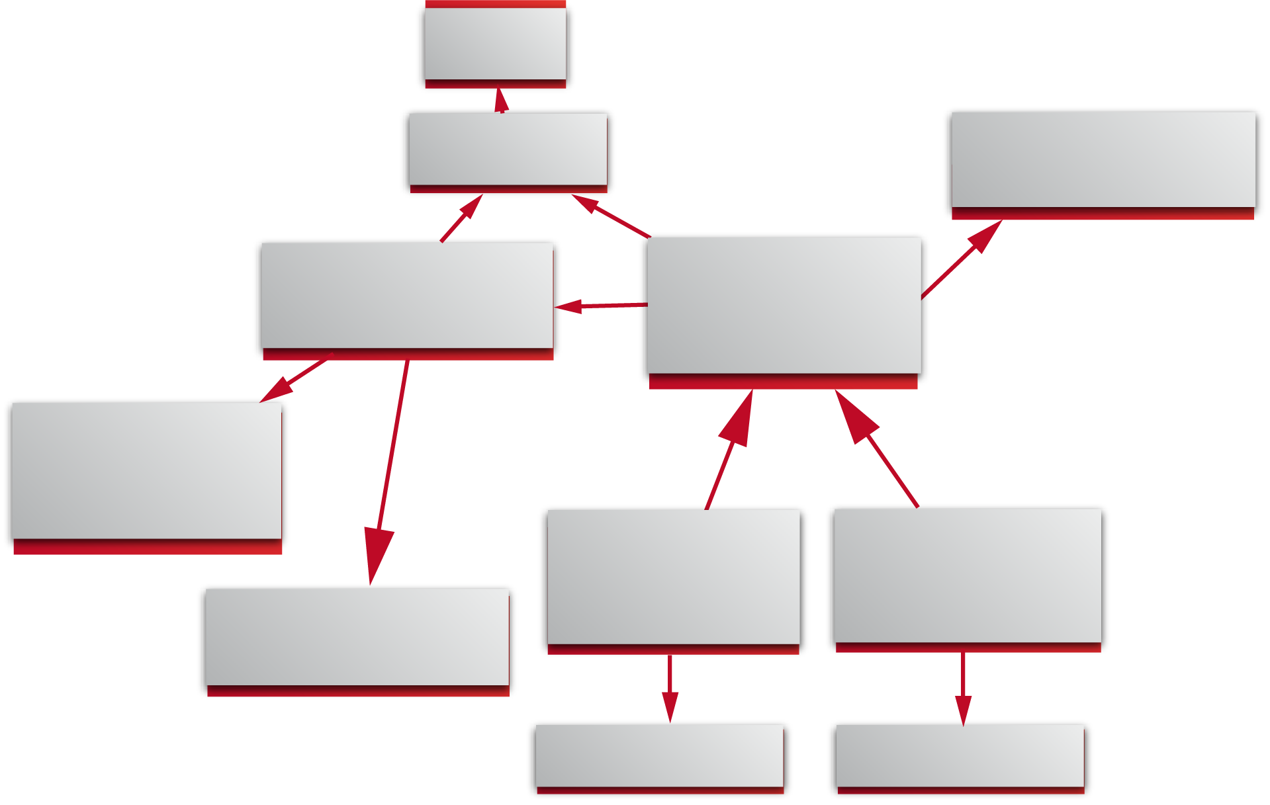
Slide 21
4.2 RESQML WellboreFrame using WITSML data
Wellbore
Wellbore Interpretation
WITSML Log Reference
WellboreTrajectory & WITSML Trajectory Reference
Wellbore Frame
MD Information
Continuous property Values
Continuous property Values
Parametric Line (Minimum-Curvature)
External Reference
External Reference
Notes:
I do not have time here to develop the full UML construction elaborated for our data model. Here is a simplified view of how the elements are constructed to import the various pieces of the WITSML Well information, so that it can be incorporated in the RESQML World:
A Well Feature is defined. A Well Interpretation is attached to it.
This interpretation is constituted of two main entities:
the Wellbore Trajectory Interpretation one ( remember that we may be willing to work in seismic time or in several different depth converted structural models scales)
and the Wellbore Frame which contains all the technical values we want to use in our models

Slide 22
Slide 22
4.3.1 Connecting to the Grid: Blocked well frame
MEASURED
DEPTH
FACEEXIT
FACEENTRY
FRAME
CELLS
No Grid
12
NoGrid
Grid 0,54+
NODE
INTERVAL
Grid 0,28
24
Grid 0, 78-
Grid 0, 43+
Grid 0,54
35
Grid 0, 82-
Grid 1, 23+
Grid 1,3
47
Grid 1, 82-
Grid 1, 23+
Grid 1,73
Notes:
How does this work for the Grid information?
The Grid elements we want to connect with the well data are either face exit and entries, or cells.
They get their positioning respectively from Nodes and Segments.

Slide 23
Slide 23
4.2.2 Connecting to Stratigraphy
FRAME
MARKERS
UNITS
Brent
12
Top
Dunlin
NODE
INTERVAL
Dunlin
24
Top
Talbert
Talbert
35
Top
Ranoch
Ranoch
47
Top T1
T1
Notes:
Similarly, we connect the Stratigraphy information , consisting of markers and Units to Nodes for the first, Segments for the second.

Slide 24

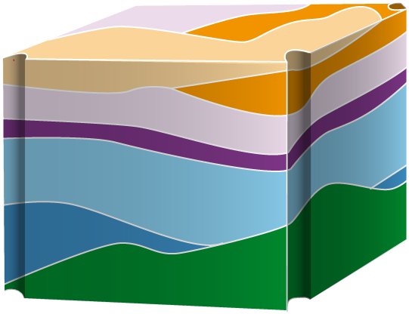

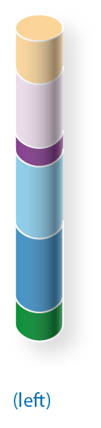

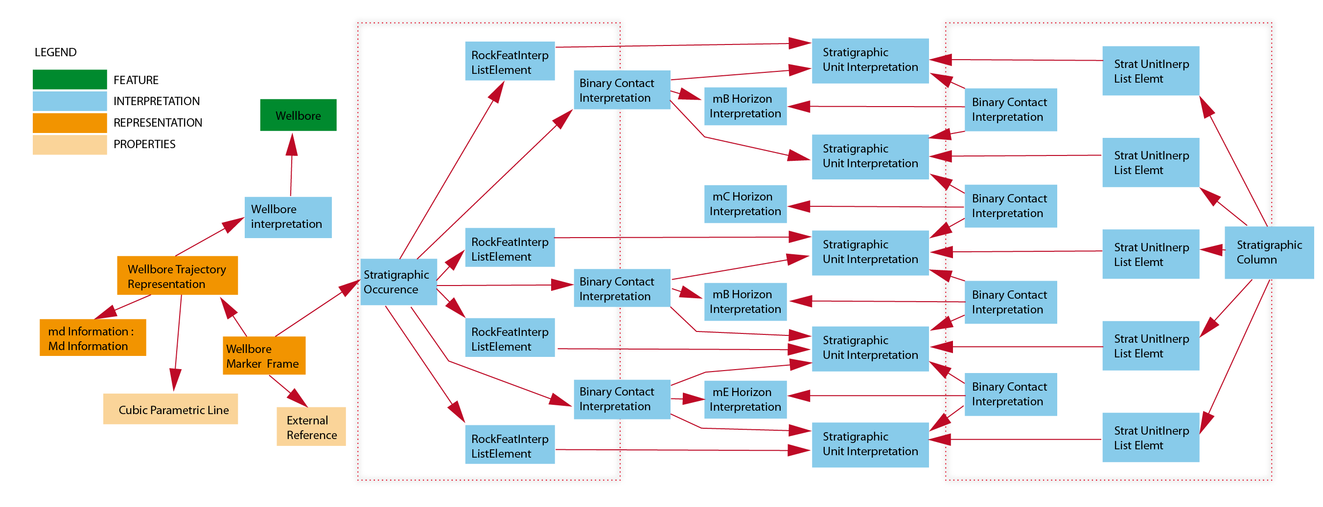
Slide 24
4.2.3 Connecting to Organizations
Chrono-Topological relationships
Notes:
It becomes really beautiful when we can see the full picture, and this is what we see by constructing the Chrono Topological relationships. I guess you grinned when I said Topological. Topology describes the smooth connection in space between elements. It is the RELATIONSHIP dimension of the positioning, which we cover in RESQML under the umbrella name of Geometry.
Here you have core samples from well B showing a missing part of the Chronostratigraphic chart that we have for our model. The stratigraphic organisation is describing not only the units but the relationship that are defining the type of contacts between two units.
Here we have four units recognized in the cored well while 5 stratigraphic units on our stratigraphic chart.
The 4 units are interpreted as such by describing the contacts both conformable and erosional.

Slide 25
Slide 25
5. This is a REVOLUTION

Slide 26


Slide 26
5. Of Relationships and Organizations
Think of relationships as hyperlinks?
What makes information important in the Google world?
Update of the model
Consistency of the model
The more links, the more
RELIABLE
QUALIFIED
VALUABLE
➔ Being able to access :
The most pertinent data
with the global picture that sustains it
Notes:
What have we constructed here and how is it different from anything else?
WITSML and PRODML have defined protocoles and predefined structures to send data from machine to machine in an undestandable way. Each of the object transfered however is totally independant from the other.
In RESQML V2 it is possible to transfer part of a model, including WITSML derived well information , with all the links and connections that make still a part of the entire model. RESQML allows to export the well data in WITMSL format, making it readable by any WITSML enabled tool.
However, when transferred as a RESQML object, it will carry with it also its connection to the other entities of the model. We can therefore speak of this as hyperlinks, as they are threads that can guide us to another piece of the puzzle related to it either structurally, or stratigraphically, or gridwise.
We realize here that these links are as many additional confirmations
that the well data is matching our understanding of the field and of the reservoir. The more links, the more confirmations. And the more confirmations, the more confident we feel in this data, right?
The number of threads can then be seen not only as a quantification of the Quality of the data, but also of its importance in the model.
What is Google engine doing? Just the same: the more connections to a site, the more popular.
We can imagine that this is also a mean to select the most important parts of our model, although it is a little early to say. What is certain is that with this exchange format, decisions are able to be made without entering complex applications, but on the most uptodate data, by you boss.
But we are not there yet…..

Slide 27
Slide 27
6. Next steps

Slide 28
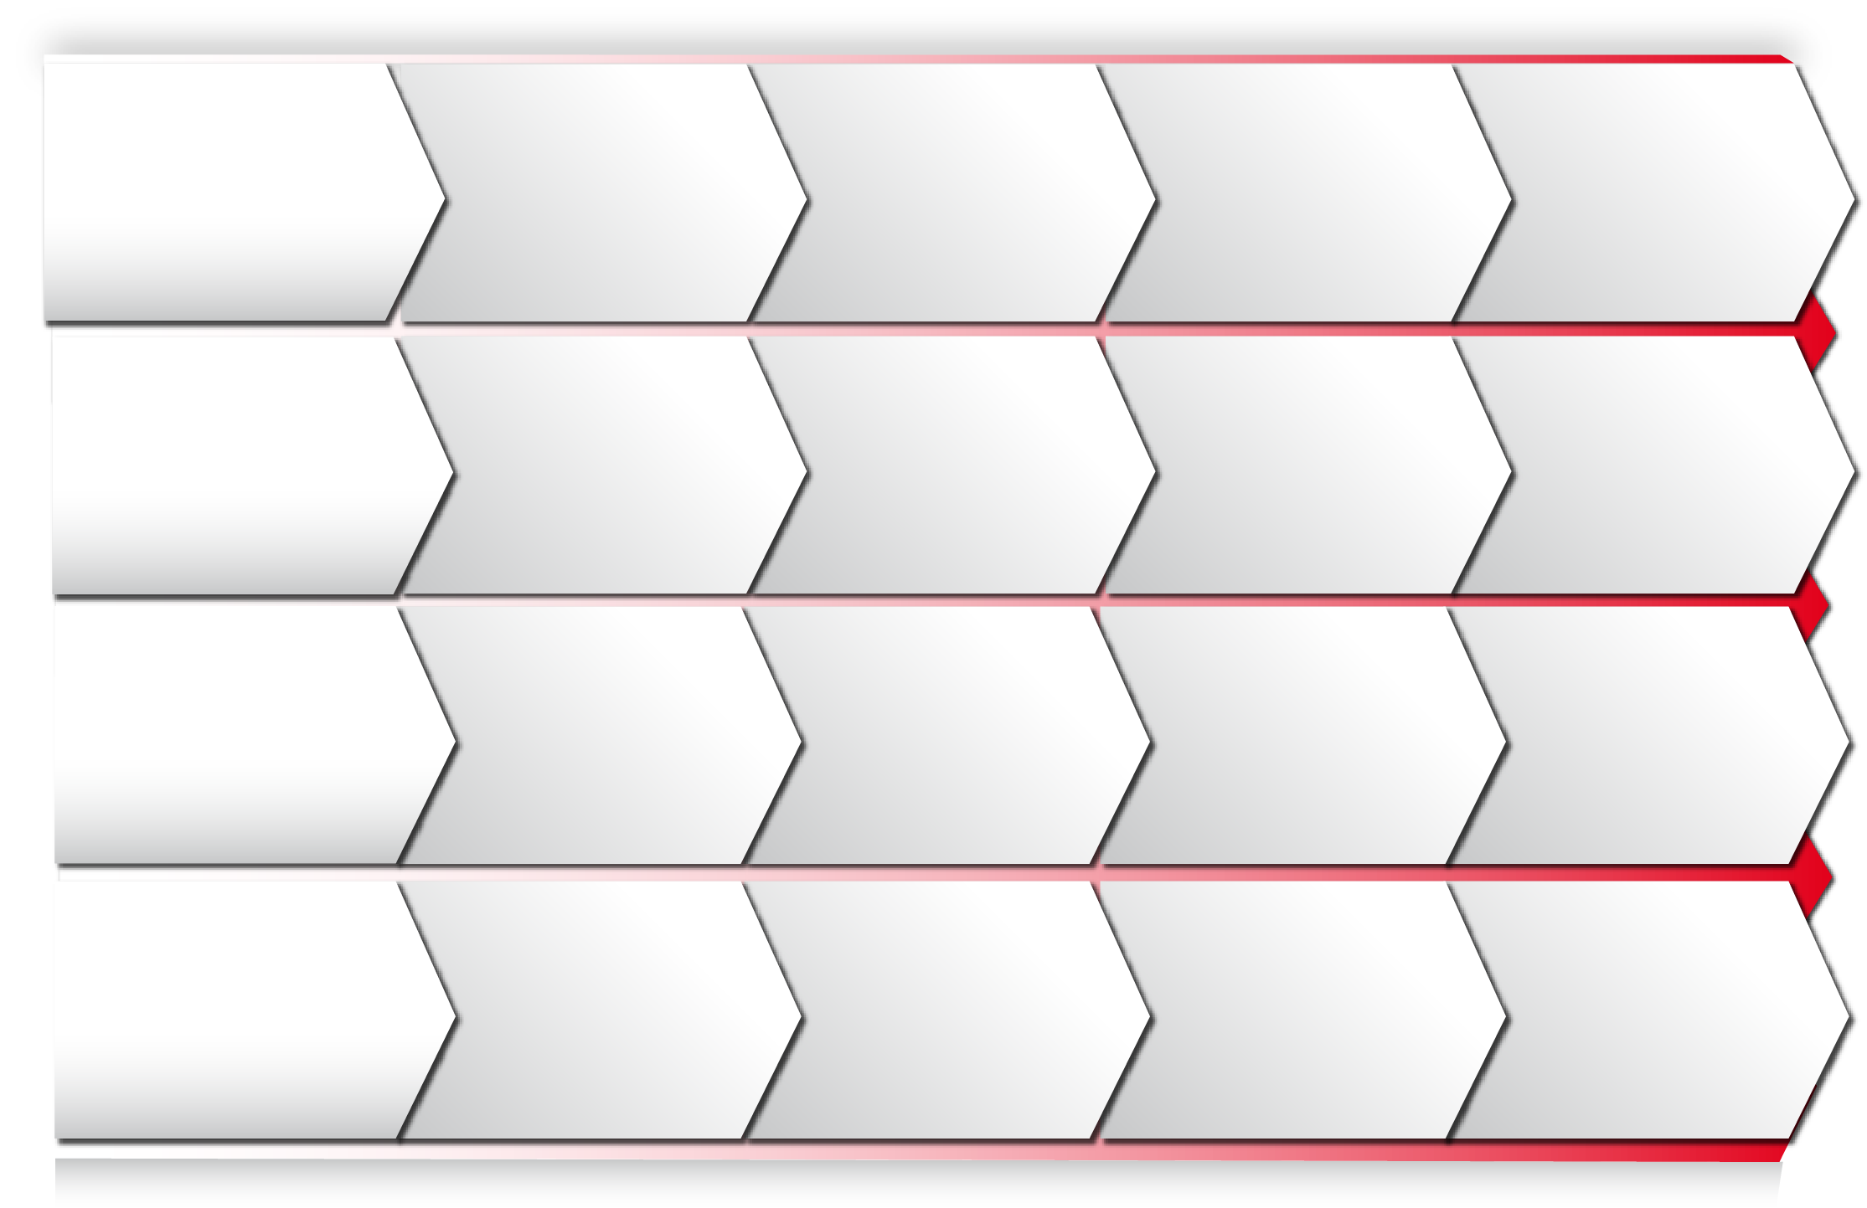

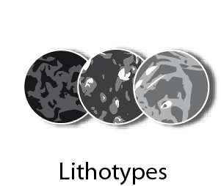

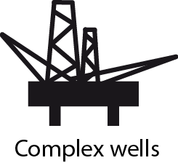
Slide 28
RESQML DEVELOPEMENT ROAD MAP
INCREMENTAL
RELEASE(S)
2010
V1.0
2013
RELEASE
2015
RELEASE
WITSML with traceability
FUTURE
2011
V1.0
2014
2016
XML, HDF binary, CRS, GUID, metadata, traceability,reference data for propertykinds, UOM, EPSG
Large model workflows
Modular documents,
packaging specification using Open Packaging
Convention
Project archival,
Activity modeling
Reservoir scale Structural/
Stratigraphic Organization
and Framework,
Geo-chronological
cross reference table
Seismic & basin scale
Structural/Stratigraphic
Organization and
Framework Filling methodology
Faults & Horizons as
individual features
Static and Dynamic
property arrays, Basic LGR’s,
faults & NNC’s
« Extended» WITSML?
Radial and Unstructured
grids Relationships with
structure improved fluid & rock properties
Grid format optimizaton
Seismic & Parametric grids Streamlines
Simulation data deck
Including Completion
WITSML trajectories,
markers, logs
PRODML objects –
production/completion,
well controls
Blocked/IJK wells
Notes:
Here is where we stand and the road map ahead for RESQML
WITSML data integration is gradually increasing in version V2 with trajectory, markers and logs
We plan to tackle PRODML objects in the following stage .

Slide 29
Slide 29
Acknowledgements / Thank You / Questions
Rewards are to be addressed to the fantastic team of the RESQML SIG, supported by Total, IFP, Texas A&M, Geosiris, Paradigm, BP, Energistics (www.energistics.org)
Chevron , Schlumberger, Transform Software, DGI, Computer Modelling Group, Halliburton, Shell.
The group charged with defining and implementing the RESQML data standard includes software developers, geologists, geophysicists, and reservoir engineers representing oil companies, oilfield services, and technology providers. These companies are members of Energistics, a not-for-profit consortium responsible for the development and maintenance of upstream oil and gas data exchange standards.
Paper # • Paper Title • Presenter Name
SPE-166486-MS • Delivering Key WITSML .. • R.C.Henri-Bally
Notes:
I would like to restate that this is a journey,
that is made possible by our companies which sustain the Energistics program,
and by the fantastic talent and energy of each and every one of the members of the Energistics SIG teams sharing this vision.
Thank you

